Slide 1
Submitted By Name: Gowshika M Reg.No: 962821205021 Dept: Information Technology
Face Expression Detection using Convolutional Neural Networks(CNN)

Slide 2
PROJECT TITLE
Face Expression Detection using
CNN

Slide 3


AGENDA
Problem Statement
Project Overview
End Users
Solutions and Proposition
Key Features
Modelling
Results
3/21/2024 Annual Review

Slide 4

PROBLEM STATEMENT
Develop a CNN-based emotion recognition model that can accurately classify human emotions (e.g., happy, sad, neutral) from facial images.
Train the model using a labeled dataset and evaluate its performance to achieve high accuracy in emotion prediction.
Save the trained model for future use in real-time emotion recognition applications.

Slide 5

PROJECT OVERVIEW
The project aims to develop an emotion recognition system using CNN and image data, capable of detecting emotions like happiness, sadness, and neutrality from human facial expressions.
Through training and testing on a labeled dataset, the system will learn to accurately classify emotions, facilitating applications in mood detection, human-computer interaction, and sentiment analysis.
The model's performance will be evaluated for accuracy and robustness, and the trained model will be saved for deployment in real-world scenarios, such as emotion-aware systems and virtual assistants.

Slide 6
WHO ARE THE END USERS?
Mobile app developers
Educational institutions
Healthcare professionals
Customer service departments
Entertainment industry

Slide 7

SOLUTION
Emotion Recognition System using CNN for accurate emotion classification.
Trained model for real-time emotion
detection from facial images.
Integration with applications for
personalized user experiences.

Slide 8
Proposition
1. Enhanced user engagement and satisfaction through personalized interactions.
2. Improved mental health monitoring and therapy
support in healthcare.
3. Efficient sentiment analysis for customer feedback and
service improvements.
4. Interactive educational tools for student engagement
and performance assessment.
5. Immersive experiences in gaming and entertainment
industry through emotion-aware systems.

Slide 9

THE WOW IN YOUR SOLUTION
The project's wow factor lies in its ability to accurately detect and classify human emotions from facial expressions, enabling personalized interactions, mental health monitoring, and immersive experiences across various industries.
3/21/2024 Annual Review
9

Slide 10
MODELLING
Data Collection and Preprocessing:
Gather a diverse dataset of human facial images labeled with emotions (happy, sad, neutral, etc.).
Preprocess the images by resizing, normalizing pixel values, and augmenting data for improved model generalization.
Model Development:
Design a Convolutional Neural Network (CNN) architecture for emotion recognition.
Train the CNN model using the preprocessed dataset, optimizing hyperparameters for accuracy and performance.
Evaluation and Deployment :
Evaluate the trained model's performance using validation and test datasets, analyzing metrics like accuracy and loss.
Deploy the model for real-time emotion recognition applications, ensuring seamless integration and usability.
10

Slide 11
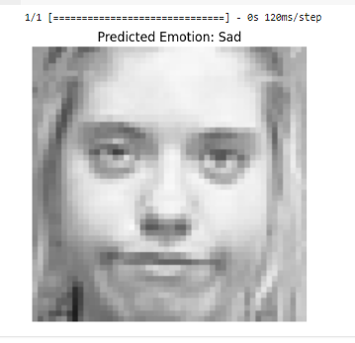
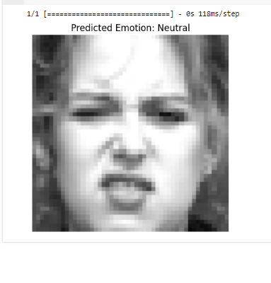
RESULTS
11

